Slide 1
OCR BASED PRODUCT INFORMATION
By
Arun Kavi JS

Slide 2
Workflow:
Image Input: The module will take an image of a product label as input.
OCR Processing: The OCR engine will process the image to extract text from the label.
Data Extraction and Cleaning: The raw OCR output will need to be processed to extract relevant information like product name, brand, ingredients, barcodes, etc. This step will involve cleaning the text (removing noise, special characters, handling potential OCR errors).
Database Query: The extracted information (especially the barcode, if available, or a combination of product name and brand) will be used to query the Open Food Facts database.
Result Retrieval: If a match is found in the database, the corresponding product details will be retrieved.
Output: The module will output the retrieved product details. If no match is found, it should provide a suitable indication.

Slide 3
easyocr: A Python package for Optical Character Recognition (OCR) that supports multiple languages and is relatively easy to use.
streamlit: A Python library for creating interactive web applications with minimal coding, which can be useful for building a user interface to upload images and display results.
requests: A widely used Python library for making HTTP requests, which will be essential for interacting with the Open Food Facts API.
opencv-python (cv2): A comprehensive library for computer vision tasks, which you might use for image preprocessing before OCR (e.g., resizing, cropping, color adjustments, noise reduction).

Slide 4
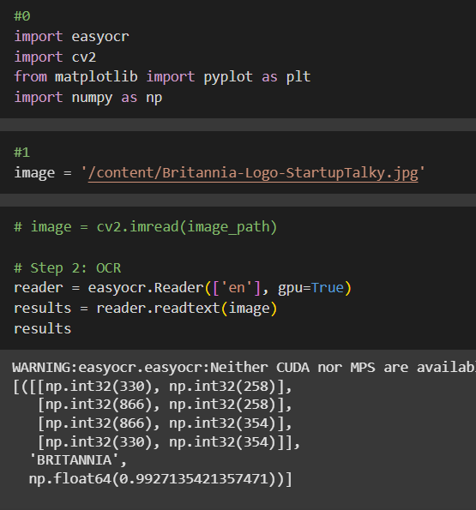
To extract visible text from a food product image using EasyOCR, which will serve as input to query product details from external food databases.
This code initializes an OCR engine with the English language and GPU acceleration (if available), then readtext() to the image.
This facilitates an automated flow from image input → text extraction → product info retrieval, forming the core of the project.

Slide 5
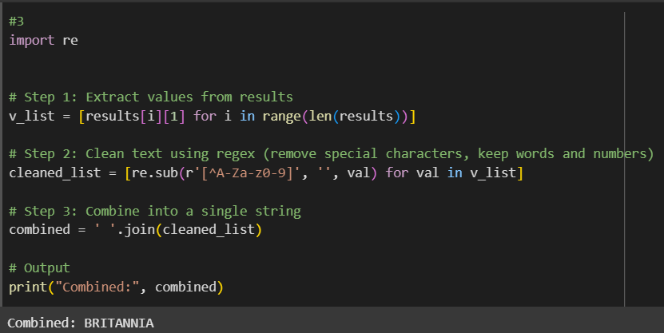
Text Preprocessing – Insights
Objective
To clean the raw text extracted from the image using OCR by:
Removing unwanted special characters
Retaining only alphabets and numbers
Producing a clean, unified string for querying product databases.
OCR outputs often contains noisy data: extra symbols, punctuation and inconsistent casing.
Cleaning ensures high accuracy during search queries to external APIs like Open food facts.
Makes the system more robust and ready for real –world images that include marketing text, logos, and clutter.

Slide 6
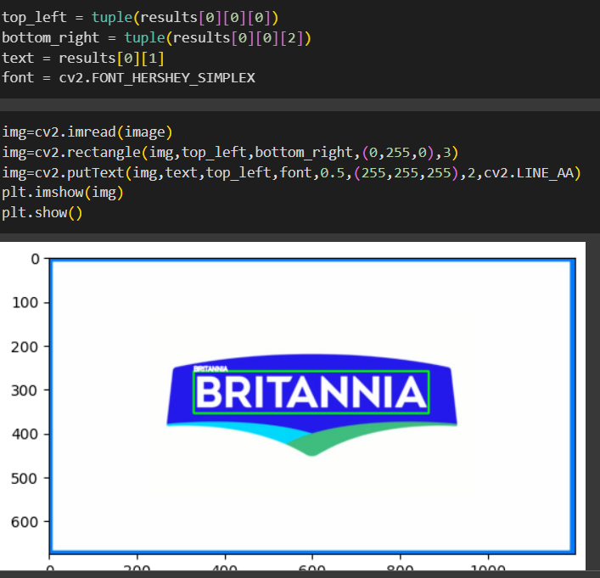
Draws a green rectangle around the detected text region.
Annotates the top-left corner with the extracted text in white font.
Displays final image using matplotlib..
📸 Visualization Insight:
The product logo "BRITANNIA" is clearly boxed in green.
Readability and precision of OCR output is high confidence.

Slide 7
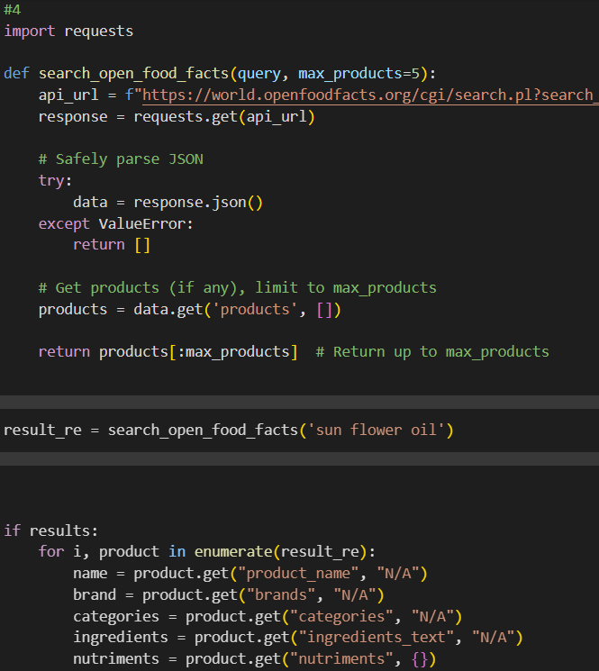
The response is parsed safely to avoid runtime errors due to malformed or missing data.
Products are extracted from the 'products' key, and limited to a maximum number (e.g., 5) to ensure performance and relevance.
Products are extracted from the 'products' key, and limited to a maximum number (e.g., 5) to ensure performance and relevance

Slide 8
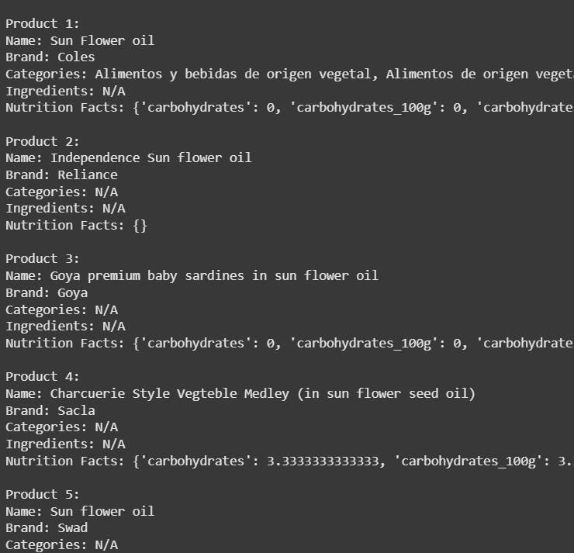
5 products were successfully fetched using the Open Food Facts API.

Slide 9
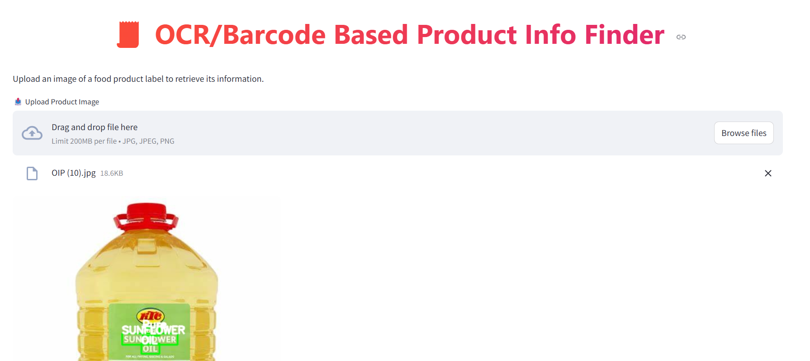
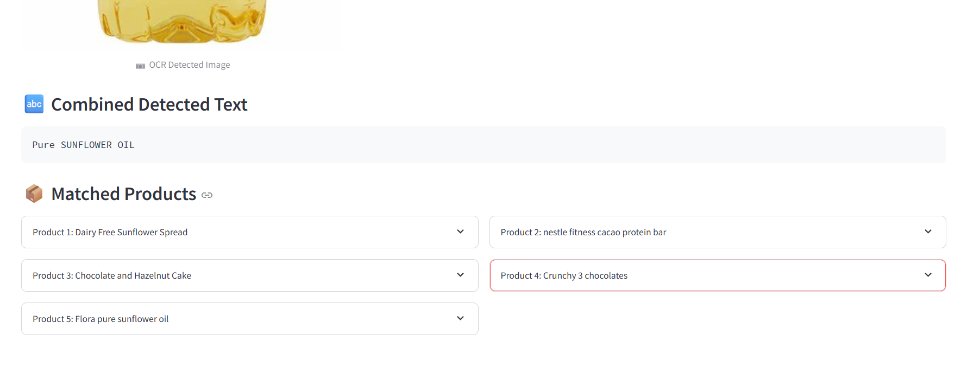
Clean Streamlit UI for:
Uploading product image
Viewing OCR text output
Displaying matched product list
Dropdown menus to expand and view product details

Slide 10
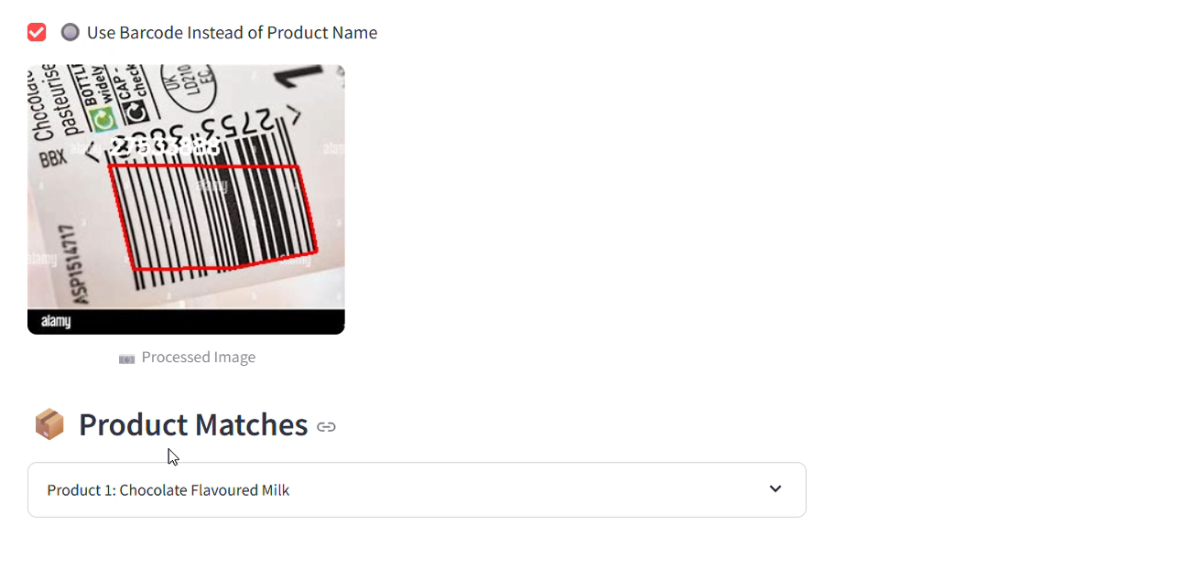
Extended Functionality with Barcode
You added barcode detection using pyzbar to extract EAN/UPC codes from product images.
This gave accurate and complete product data (no ambiguity like in OCR name searches).
Deployment Issues (pyzbar)
Pyzbar can be tricky due to environment-specific dependencies like:
Compatibility issues on cloud platforms or Windows
These issues likely blocked deployment to platforms like Streamlit Cloud or Heroku

Slide 11
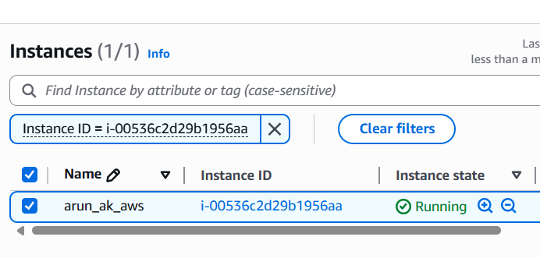
Also I have deployed in my AWS EC2 instance.

Slide 12
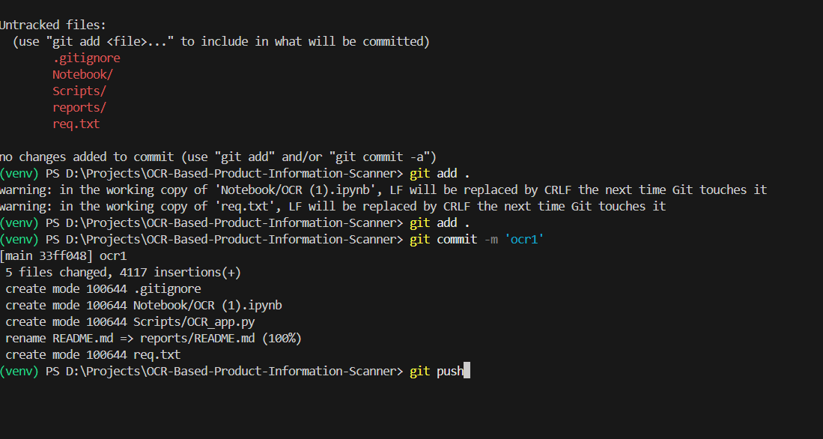
PUSHING TO MY GIT REPO

Slide 13
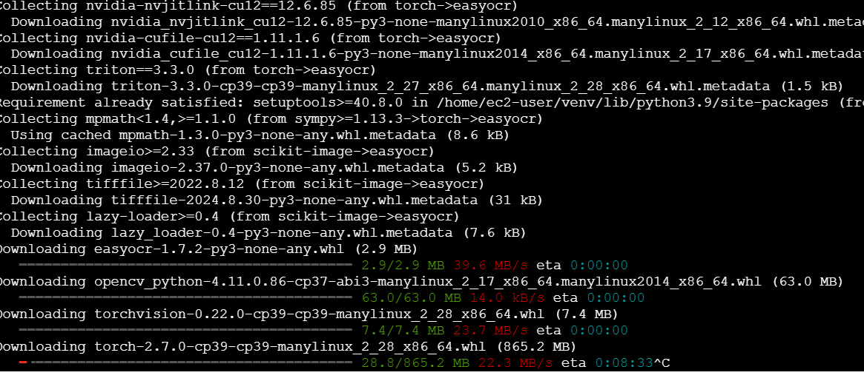
Try to deploy in aws ec2 but I have only free tier of 1gb ram , its very slow

Slide 14
Conclusion
This project demonstrates the end-to-end pipeline of an intelligent food product label scanner using computer vision, OCR, and product matching APIs. From image input and text extraction to product data retrieval and visualization, the application showcases how deep learning and practical AI techniques can be integrated into a real-world solution.
The use of OpenCV, easy OCR, Pyzbar for barcode scanning, and integration with public food datasets like Open Food Facts highlights the power of open-source technologies in building scalable, intelligent systems.

Slide 15
Acknowledgements
Special thanks to:
OpenCV and easy OCR for reliable image processing and text recognition.
Open Food Facts API for product data access.
Streamlit for simplifying UI deployment and interactivity.
The open-source community for continuous innovation and knowledge sharing.

Slide 16
Special Thanks
I would like to express my sincere gratitude to Qurinom Solutions for providing this opportunity and platform to explore, innovate, and build this project. Their support and guidance have been instrumental in transforming a concept into a functional solution.

